Slide 1


Computer Networks: A Comprehensive Overview
Explore the interconnected world of computer networks. This presentation covers everything from local networks to global infrastructures.
We'll define key concepts, examine various types, and discuss future trends shaping network technology.
by MILANKUMAR PARMAR

Slide 2
Local Area Networks (LANs)
LANs connect devices in a limited area, like homes or offices. They offer high-speed, low-cost, and private communication.
Characteristics
Technologies
Data Rates
High speed
Ethernet
Gigabit Ethernet (1 Gbps)
Low cost
Wi-Fi (802.11 standards)
Wi-Fi 6 (9.6 Gbps theoretical)
Private ownership

Slide 3

Wide Area Networks (WANs)
WANs span large geographical areas. They connect cities and countries, using technologies like MPLS and VPNs.
Definition
Characteristics
Examples
Network covering a large geographical area.
Lower speed than LAN, higher cost, often public.
Internet, corporate networks spanning multiple cities.

Slide 4




Metropolitan Area Networks (MANs)
MANs cover a city or metropolitan area. They offer higher speeds than WANs with lower costs.
Coverage
City-wide
Speed
Higher than WAN
Cost
Lower than WAN

Slide 5




Personal Area Networks (PANs)
PANs connect devices around an individual person. They are short-range, low-power, and typically wireless.
Bluetooth
Smartwatches
Wireless Keyboards
Connects headsets and other devices.
Wearable tech for personal use.
Short-range input devices.

Slide 6




Virtual Private Networks (VPNs)
VPNs create secure, encrypted connections over public networks. They ensure privacy, security, and remote access.
Privacy
Hides your IP address.
Security
Encrypts your data.
Remote Access
Access resources remotely.

Slide 7
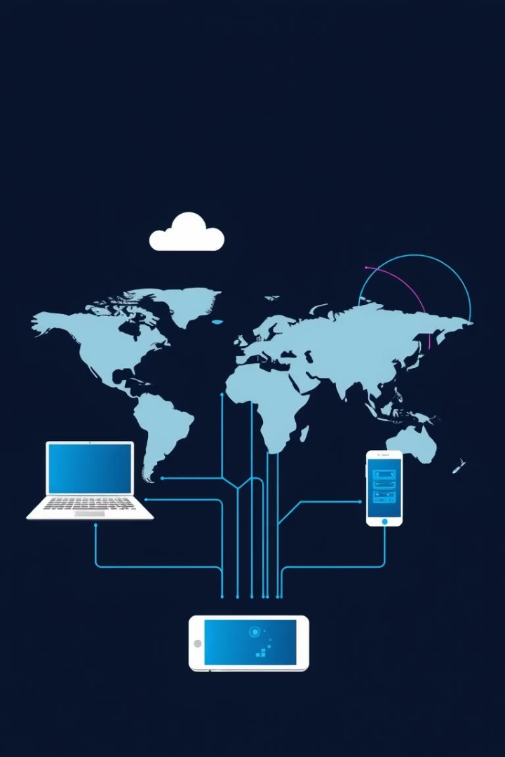
Network Types: A Quick Comparison
Let's recap the key characteristics of each network type.
Network Type
Scope
Speed
Ownership
LAN
Local
Fast
Private
WAN
Wide
Slower
Public/Private
MAN
Metropolitan
Medium
City-wide
PAN
Personal
Short-range
Wireless
VPN
Secure Tunnel
Variable
Public

Slide 8




The Future of Computer Networks
The world of computer networks is constantly evolving. New technologies are emerging to meet growing demands.
5G and Beyond
1
SDN
Higher speeds, lower latency.
2
Programmable networks.
AI
4
NFV
3
Automated management.
Virtualized appliances.

